Slide 1
Innovation and Election

Slide 2
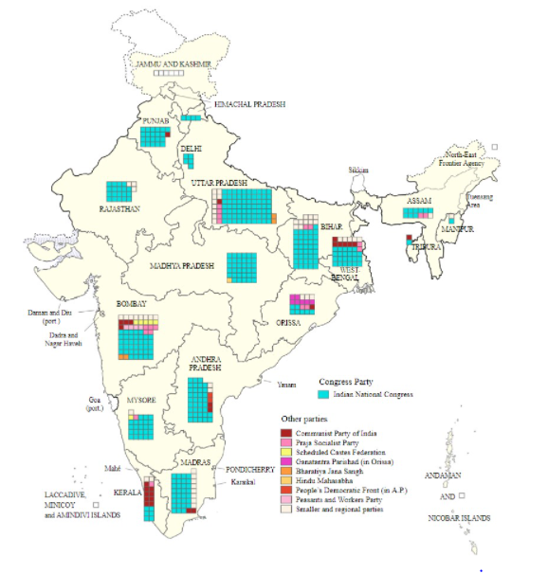
Election understanding and Modeling
The Indian general election of 1951–52, held from 25 October 1951 to 21 February 1952, was the first election to the Lok Sabha since India became independent in August 1947.[1][2][3] It was conducted under the provisions of the Indian Constitution, which was adopted on 26 November 1949. Elections to most of the state legislatures took place simultaneously.¶

Slide 3
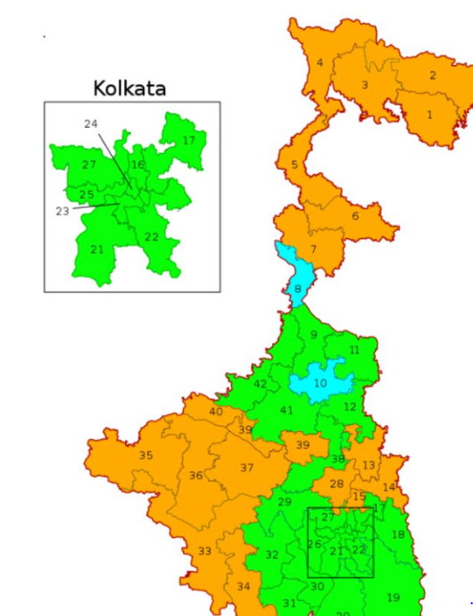
Bengal contribution
Bengal contributed 42 seats out of 543 seats for gernal election¶

Slide 4
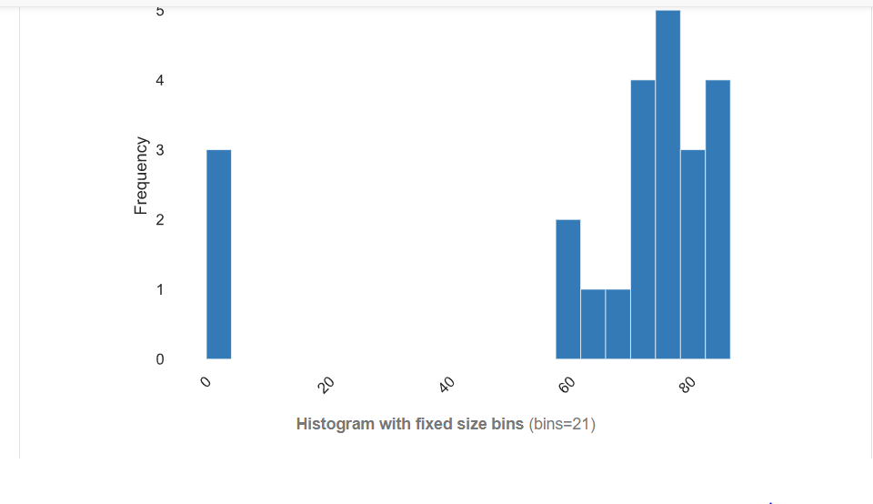
Analysis and Data-Prepration
Scrapping the data from wikipedia for the population distribution in west bengal
Source of the data is Wikipedia
Data Description
District : District of Bengal
Population : Population of that District
Growth rate : Growth rate of the district
Sex ratio : Sex ratio of that District
Literacy: Literacy of that district
Density per square killometer : Density of population per killometer
The chart is showing the literacy rate in bengal

Slide 5
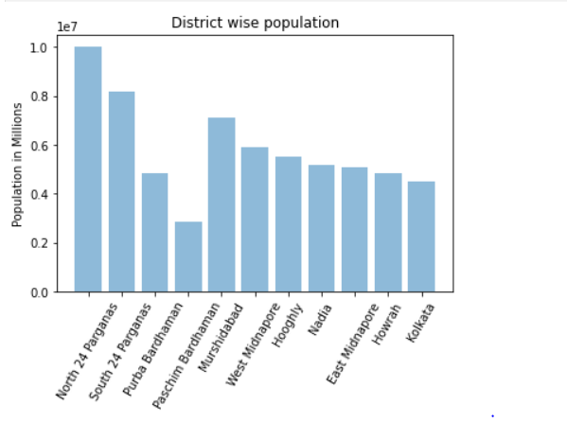
Analysis and Data-Prepration
The graph is showing the west bengal
top 10 District wise population
The main understanding of the analysis is to use the meaninful information from the make it useful for the future prediction for that ,I used lots of thing ,webscrapping ,data analysis ,model designing ,visulaization ,and prepraing the data for the model

Slide 6
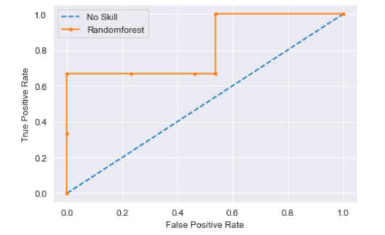
Model Designing
Election is the time when a common try to select the candidates currently with the help of Machine learning we can provide the better result based on the different survey and with past record
lots of data is currently present on the web but we need to understand what is useful and what is not we need to select the data carefully ,clean and need to make useful for the model.
The figure is Area under the curve and provide the information for true positive rate to false positive rate

